Slide 1
ANCIENT INDIAN CIVILIZATION
By: Tristan Webster

Slide 2
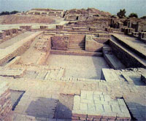
ANCIENT INDIAN SHELTER
Houses made of mud-brick & baked brick
Rulers built bigger houses
Rulers had courtyards

Slide 3
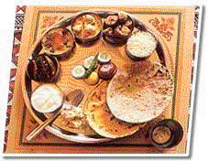
ANCIENT INDIAN FOOD
Ancient Indian meat: cows, pigs, sheep, goats, chicken
Other ancient Indian food: wheat, rice, soup, sugar cane, Figs, lentils

Slide 4
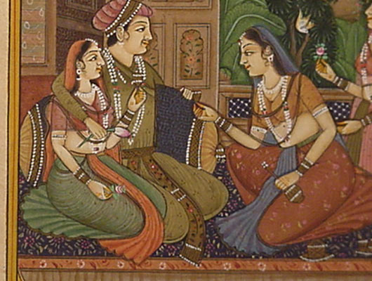
ANCIENT INDIAN CLOTHING
Men clothing: dhoti, turbans
Women clothing: sari

Slide 5
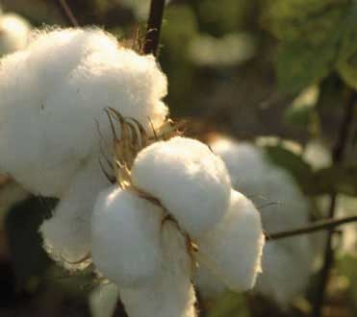
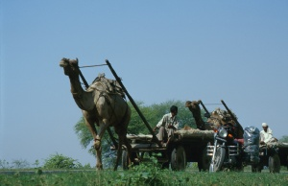
ANCIENT INDIAN ECONOMY
Animals they traded: donkeys, camels
Food they traded: spices
Other things they traded: gold, silk, pottery, cotton

Slide 6
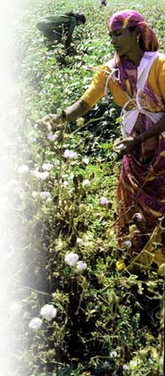
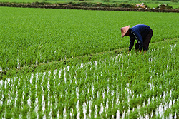
ANCIENT INDIAN DAILY LIFE/VALUES
Values: Dogs, gambling, telling stories
Daily life: Divided everyone into groups called castes, played fighting games, picked cotton, picked crops

Slide 7
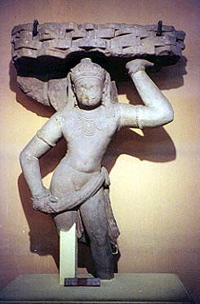
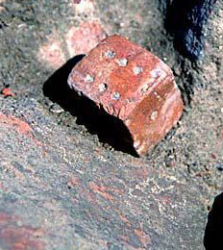
ANCIENT INDIAN ART & ENTERTAINMENT
Artwork: paintings, carved statues, sculptures
Entertainment: board games, telling the future, game of skill

