Slide 1
ANCIENT ISLAM
BY: EMMA MARIE ORLOFF

Slide 2
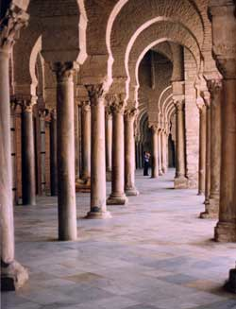
ANCIENT ISLAMIC SHELTER
THEY BUILT A LOT OF MOSQUES
THEY ALSO BUILT ALOT OF PALACES FOR ALL OF THEIR KINGDOMES
ALL OF THE KINGDOMES WHERE RULED BY THE ISLAMIC EMPIRE

Slide 3
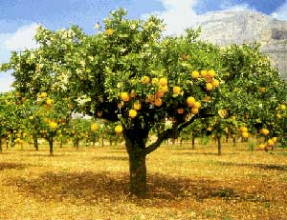
ANCIENT ISLAMIC FOOD
THEY ATE WHEAT, PIG, SHEEP, BREADS, SUGAR CANE, SPICES, AND FRUITS
THEY DRANK OLIVE OIL, WINE, AND TEA

Slide 4
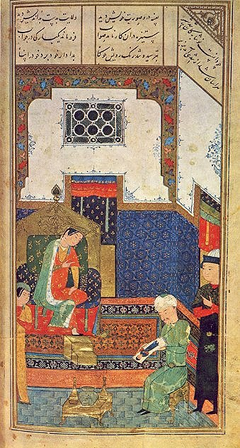
ANIENT ISLAMIC CLOTHING
THEY WORE LONG TUNICS
THEIR TUNICS WERE MADE OF LINEN, COTTON, OR SILK
THE WOMEN WORE LOOSE PANTS UNDER THEIR LONG TUNICS

Slide 5
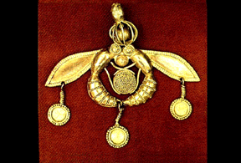
ANCIENT ISLAMIC ECONOMY
THEY TRADED WITH CHINA, AFRICA, THE MEDITERRANEAN, AND WEST AISA
THEY TRADED FOR FROM CHINA: COTTON CLOTH, PAPER, FURS, LACQUERWORK, AND JADE
THEY ALSO TRADED FOR FROM AFRICA, THE MEDITERRANEAN, AND WEST AISA: GOLD, SILVER, IVORY, GLASS, AND JEWELS

Slide 6
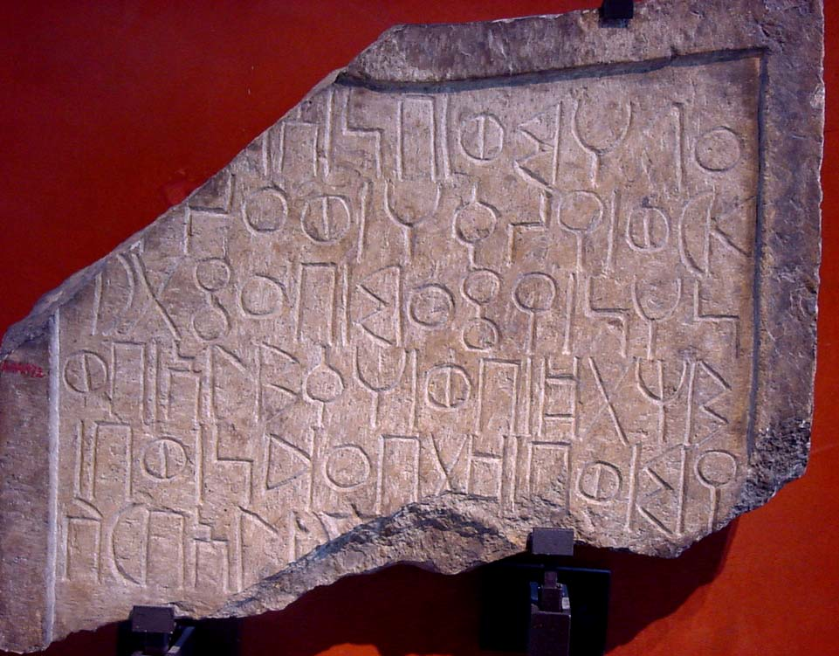
ANCIENT ISLAMIC DAILY LIFE/VALUES
CHILDREN DID WHAT THEIR PARENTS DID
THE GIRLS DID NOT GO TO SCHOOL
BOYS STARTED SCHOOL WHEN THEY WERE SIX, BUT ONLY IF THEY WERE WELTHY ENOUGH TO PAY TO GO TO SCHOOL
MEN WERE ALOUD TO HAVE AS MANY AS FOUR WIVES, BUT ONLY IF THEY WERE WELTHY ENOUGH TO TAKE CARE OF THEM ALL
MOST MEN ONLY HAD ONE WIFE

Slide 7
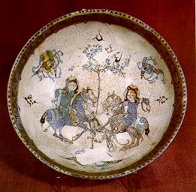
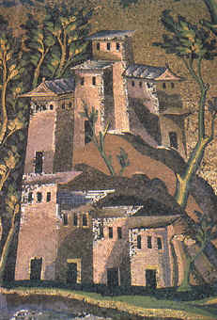
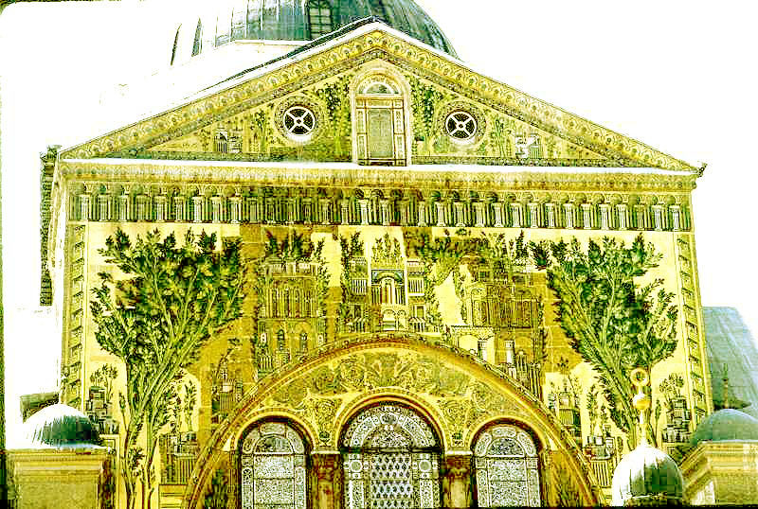
ANCIENT ISLAMIC ART/MUSIC/ENTERTAINMENT
THEY MADE POTTERY, AND THEN PAINTED DESIGNS ONTO THEM
THEY PAINTED MOSAIC ART SHOWING PLANTS AND BUILDINGS ONLY

Slide 8
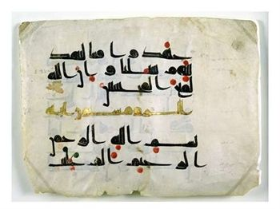
ANCIENT ISLAMIC RELIGONS
THERE WERE SIX DIFFERENT RELIGONS IN ANCIENT ISLAMIC TIMES
THEY WERE KORAN, HAJI, SUNNI, SHIITE, SUFI, AND JEWS UNDER ISLAM
KORANS SAY NOT TO DRINK WINE OR BEER
NOT MANY WOMEN DID THE HAJI.
SUNNI AND SHIITE WERE SUPPORTERS OF ALI
SUFI WANTED MORE RELATIONSHIP WITH GOD
THE JEWS HELPED THE ARABS CONQUER SYRIA AND ISRAEL

