Slide 1
Ancient India
Caitlyn Blake

Slide 2
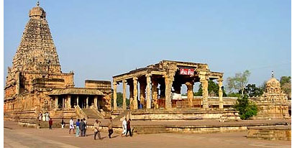
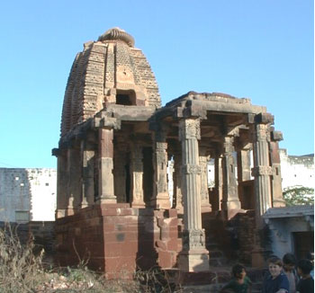
Shelter
Some temples were made out of rock or mud brick
The Mauryan architecture was that they built their houses inside mountains
In the medieval times they had two styles of temple building, a north India style and a south

Slide 3
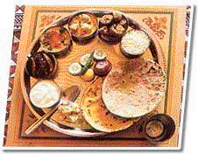
Food
They mainly ate:
Wheat & rice
But also ate
Lentals
Cinnamon
Sugar
Pepper
Pigs
Chicken
Salt

Slide 4
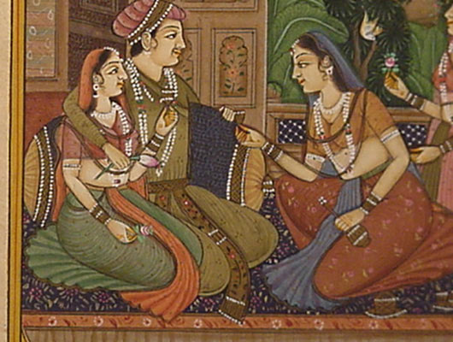
Clothing
Indians mostly wore cotton saris (clothing)
The rich sometimes wore silk saris
Most saris are five to six feet long
Young women wore colorful saris while older women, mourners, and widows wore white saris

Slide 5
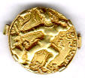
Economy
Indians traded: cotton, gold, silk, and pottery
They traded goods on donkeys and camels
The goods were not always safe and the donkeys and camels could not hold much
After a while they decided to use ships because it was safer and easier

Slide 6
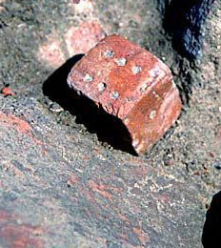
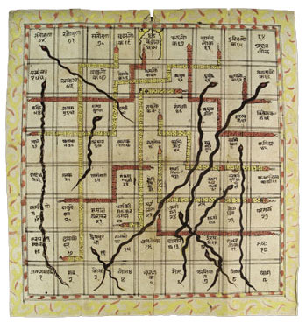
Games
Indians threw the knucklebones of sheep and pigs to tell the future
Later, they turned square knucklebones into dice by carving holes into the knucklebones to make the dots
They also played jacks, chutes & ladders, and chess
Boat races, camel races, and wrestling were also played

Slide 7
Slavery
Indians started with few slaves but over time India got more and more slaves
The slaves were mostly house slaves
Some of the slaves were children
People took children from their parents and killed them
People became slaves if they did not pay off a loan

Slide 8
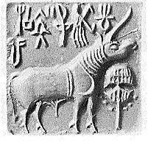
Language and Literature
The earliest known writing systems came from India
People used the Harappan writing system to mark their property
But unfortunately we can’t read it
The Harappan writing system was forgotten
Around 500 BC people started to write again after seeing the Persians write

Slide 9
Animals
The most important animal was cattle
Chickens reached India from Thailand or China
Cows made yogurt
Tigers, monkeys, and big snakes lived in the forests
Camels and elephants were also import

Slide 10
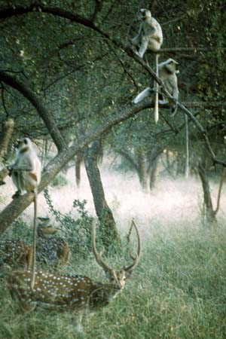
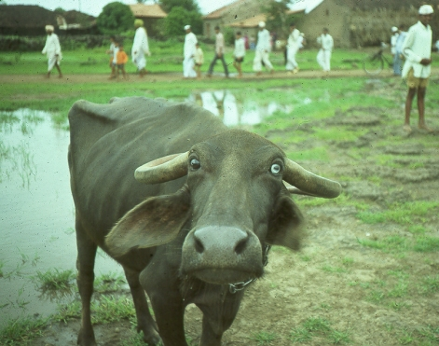
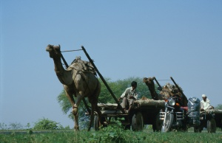
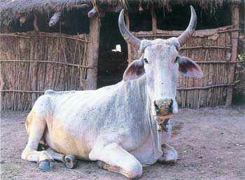
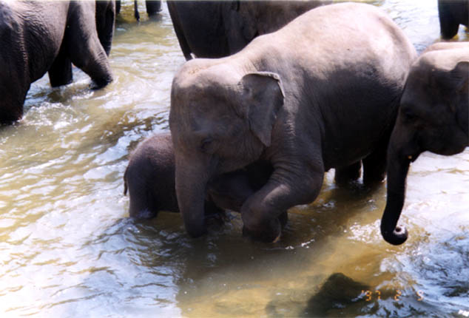
Here are some of the animals in India ☺

Slide 11
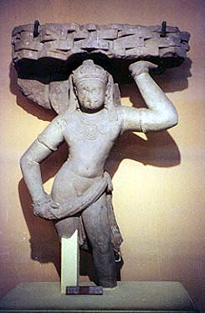
Indian Art
Alexander the Great had an important impact on Indian Art
The first life-sized statues dated back to the 200s BC
The Indians made statues about Buddha’s life
These statues were very popular

Slide 12
Indian Medicine
People said that diseases were caused by bad spirits
They also said that you treat diseases by killing the bad spirits with poisons and spells
The surgeon Sushruta left a book with all his surgical methods
By about 200 AD doctor’s gave up on the idea of bad spirits because of less wrong ideas

Slide 13
Guptan History
The Guptans had kings
India was very rich and powerful because of the Guptan kings
In 455 AD - the Huns an army, invaded India and destroyed the Guptan Empire
After that, India was split into two small kingdoms

Slide 14
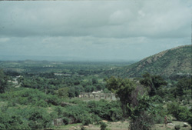
Indian Environment
In most of the year, it is hot and dry
Around May, clouds would come and it would get very dull
And finally, it would start raining
It came down by the bucket load!

Slide 15
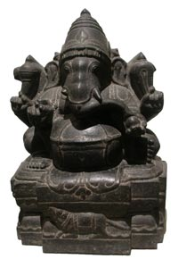
Religion
Ganesh cursed the moon
Ganesh cursed the moon saying, anyone that looked at it would do something bad. He cursed the moon because the moon called him babyish because he was greedy.
Hindu
The word Hindu comes from the river Indus. It just means people who live near the river. The people who live there carved images of several different gods on their clay seals.

Slide 16
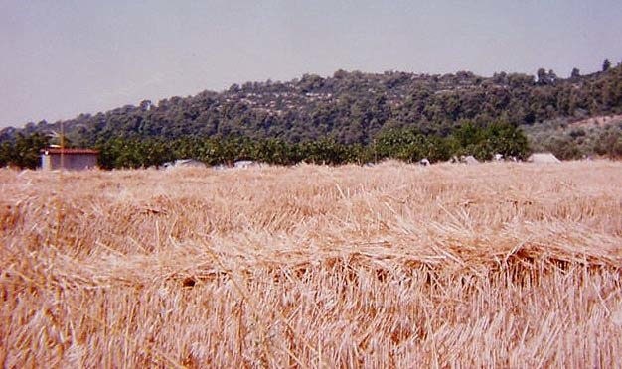
THANK YOU FOR LEARNING ABOUT INDIA WITH US!!!!!!!☺

