Slide 1
Vikings
Kheira Tuck & Karl Malicdem

Slide 2
Viking’s shelter
The houses were made of:
*wood
*stone
*block
*turf
*wattle

Slide 3
Viking’s Food
Vikings ate:
*oats *butter bread
*barley *butter
*wheat
*cabbage
*onions
*beans
*flour
*porridge
*meat
*berries
*nuts
*fish
*milk
*cheese

Slide 4
Viking’s Clothes
Men wore:
*tunics
*trousers
Women wore
*dresses
The clothes were made out of
wool, animal skin and linen.

Slide 5
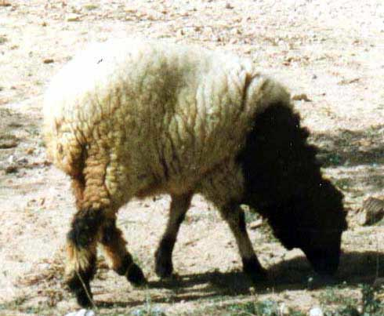
Viking Economy
They traded:
*fur
*wool
*shoes
*gold coins
*silver coins
*silk

Slide 6
Daily Lives
They collected:
*wood
They made:
*clothes
*weapons
*houses
*bread
*boats

Slide 7
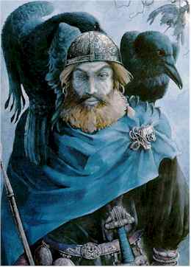
Beliefs
They had many gods like:
*Thor
*Odin
*Freya

